Slide 1
DeepskyLog
September 17, 2011

Slide 2
History of DeepskyLog
August 2003 : First ideas, astronomylog
End july 2004 : Official start, first lines of code, project available at murzim (Aalst) website
September 29, 2004 : 4 testers
October 9, 2004 : First operational version

Slide 3
History of DeepskyLog
November 26, 2004 : DeepskyLog
December 7, 2004 : DeepskyLog 1.0 at http://www.deepskylog.be/
Februari 22, 2005 : DeepskyLog 2.0
  Search on observations
  pdf files for objects and observations
  The 'club' concept
  DeepSkyLive link

Slide 4
History of DeepskyLog
July 2, 2005 : DeepskyLog 2.1
  Import and export of observations in csv format
  Easier to add different observations of 1 night
  Adapted version of SAC database
  Search on object diameter
November 9, 2005 : 5000 observations

Slide 5
History of DeepskyLog
2006 : DeepskyLog 2.2
  Search on limiting magnitude and seeing
  Export objects to csv format
  Sort objects on seen/not seen
  Search observations
    with drawings
    with instruments with a certain diameter
May 28, 2006 : 10000 observations

Slide 6
History of DeepskyLog
May 31, 2006 : DeepskyLog 3.0
  Module concept : Comets
  Cross queries for observations of Deepsky objects
  More than 25 entries in 'Most active observers' and 'Most seen objects'
  Search for text in observations
  IE errors

Slide 7
History of DeepskyLog
October 2006 : 3th developer (David Erzeel)
November 2006 : cooperation with the 'Fachgruppe ComputerAstronomy'. Common format to import / export observations.

Slide 8
History of DeepskyLog
StarNights 2007 : DeepskyLog 3.1
  Search observations not done by yourself
  Overview of nearby objects
  Sort on Messier, Caldwell, ...
  Internationalisation : Language field
  Addition of visibility (Easy → not visible)
  Local time
  New instrument types

Slide 9
History of DeepskyLog
December 16, 2007 : 20000 observations
June 26, 2008 : DeepskyLog 3.2
  Observing lists
  Import and export of observing lists
  Calculation of contrast reserve for objects
  Addition of filters, eyepieces, lenses

Slide 10
History of DeepskyLog
January 7, 2009 : DeepskyLog 3.3
  New layout
  "Last seen" column for objects
  Compulsary fields are highlighted
  Extra fields for observations (OAL)
  Number of objects from list for 'Popular objects'
  Own notes for objects in list

Slide 11
History of DeepskyLog
April 10, 2009 : 30000 observations
June 25, 2009 : DeepskyLog 3.4
  RSS Feed
  Menu's are collapsible
October 9, 2009 : DeepskyLog 3.5
  Star charts
  <OAL> compatibility
  Moon

Slide 12
History of DeepskyLog
November 26, 2009 : DeepskyLog 3.6
  Constellations on the starcharts
  Observations of Tom Polakis online
  > 38500 observations (> 7000 in English)
February 9, 2010 : DeepskyLog 3.7
  Starchart are printable
  Stars up to magnitude 16.5
  Ephemerids sun, moon, twilight

Slide 13
History of DeepskyLog
March 14, 2010 : 40000 observations
March 30, 2010 : DeepskyLog 3.8
  Calculation of rise, transit and setting of objects
  Moon phase shown at detail of observation
  Columns are 'shrinkable' and moveable

Slide 14
History of DeepskyLog
June 5, 2010 : DeepskyLog developer day. 5 developers
June 7, 2010 : DeepskyLog 3.9
  Extended PDF reports
  Remembering query parameter after search
  Consequent name of objects
  Possibility to save queries of objects and observations

Slide 15
History of DeepskyLog
October 6, 2010 : DeepskyLog 4.0
  Extended maps for observing lists (pdf format)
  Activate / deactivate telescopes, eyepieces, locations
  ICQ export for comets
  Yearly ephemerids for objects
  Menu's at top and left can be hidden

Slide 16
History of DeepskyLog
December 8, 2010 : DeepskyLog 4.1
  Best period visible for observing lists
  Messaging system
April 8, 2011 : 50000 observations
July 2, 2011 : DeepskyLog 4.2
  Addition of session concept

Slide 17
History of DeepskyLog
January 19, 2012 :
  HTML 5 forms, menu
  Google translate
  OAL 2.1
  Nicer way to display images
  Double stars
  Image catalogs downloadable
  Observer statistics
  Deep-sky atlas

Slide 18
History of DeepskyLog
May 30, 2012 : 60000 observations

Slide 19
DeepskyLog now

Slide 20
DeepskyLog now

Slide 21
DeepskyLog now

Slide 22
DeepskyLog development
Development using subversion
Mailing lijst : developers@deepskylog.be
Developers :
  David Erzeel, Wim De Meester, Jan Vanautgaerden, Chris Wauters, Laurens Ramandt, Peter Henderickx
Database : Eric Van der Jeugd

Slide 23
DeepskyLog development
php5 + mysql using eclipse
object oriented
Functionality and GUI separate
Modules
Javascript / AJAX
Transition from XHTML 1.0 strict to HTML5

Slide 24
DeepskyLog development
Redmine :
  Issue tracker
  Overview of subversion
  Planning tool
  Integration in Eclipse

Slide 25
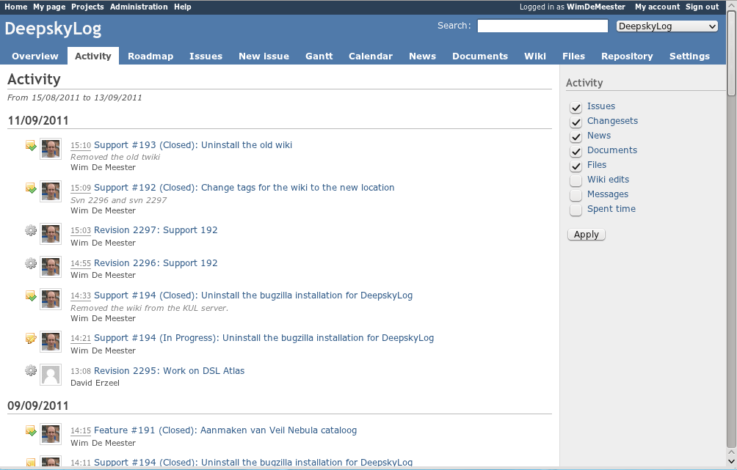

Slide 26
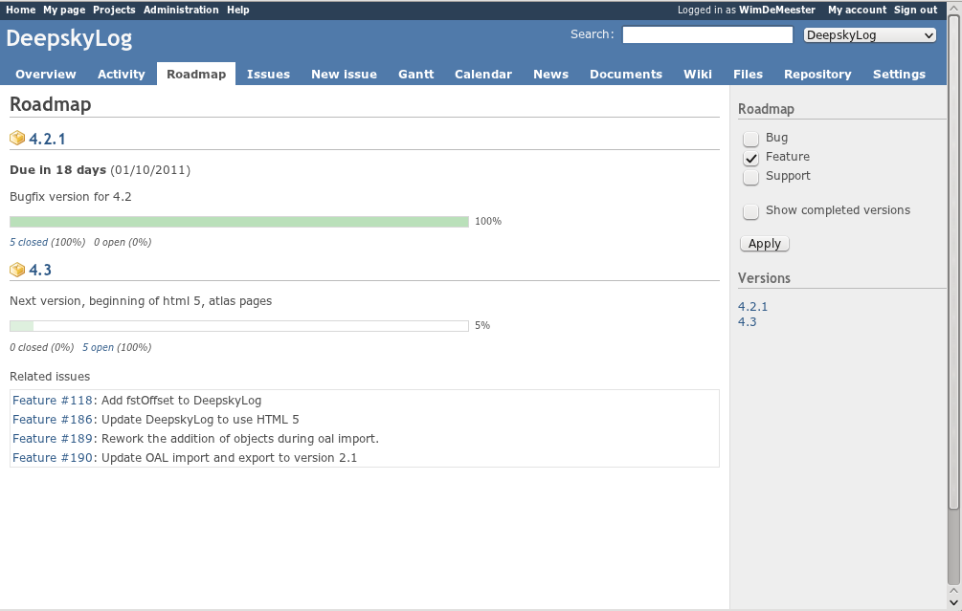

Slide 27
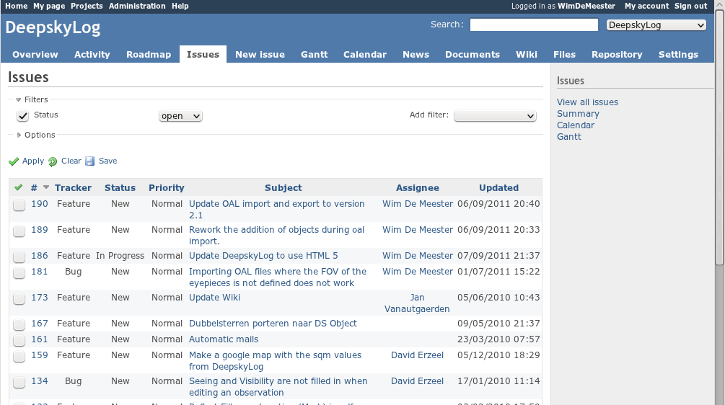

Slide 28
Future of DeepskyLog
OAL
  Upgrade to version 2.1
  Rework the addition of objects using OAL
  Add fstOffset
Upgrade to HTML5
Make a google map with the sqm values from DeepskyLog

Slide 29
Future of DeepskyLog
Bugfixing
New entry page for DeepskyLog
Make it possible to receive messages also as mails
Asteroid module?
Rework of the comets module
Usage of google translate
...

Slide 30
DeepskyLog deployment
Strongest points of DeepskyLog :
  > 50000 observations
    Possibilities to compare a lot of observations
  Messaging system to contact other observers
  Observing lists

Slide 31
DeepskyLog deployment
DeepskyLog runs on a modern webserver, located in an air-conditioned room (Institute of Astronomy – KUL).
Downtime < 24h in worst case.
Move to virtual machine planned this year → maximum downtime < 1h.
www.deepskylog.org (de and nl) and www.deepskylog.be

Slide 32
DeepskyLog deployment
Problems :
  Mysql port can not be opened, because 'not safe' enough
  Code updates are frequent, both on the development as the 'stable' version.
  Adding a common 'oculum' user for all the observations from the 'German' version is not possible, because we loose the power of DeepskyLog.

